Slide 1
Weapon Detection using Jetson Nano

Slide 2
Overview
Solution diagram
Development plan
Technology: AI model, algorithm
Demo steps

Slide 3
Overview
Introduction: The Threat of Weapon Usage
Increasing public safety concerns: Rising incidents of violence involving weapons in public spaces such as schools, malls, airports, and crowded areas.
Limitations of traditional surveillance systems:
Dependence on continuous manual monitoring → prone to oversight.
Slow reaction times in identifying threats.
Serious consequences:
Loss of lives and property.
Fear and instability within communities.

Slide 4
Overview
Solution: Intelligent Weapon Detection System Using Jetson Nano
AI-based detection system with Jetson Nano:
Automatically detects and identifies weapons in real time from camera feeds..
Sends instant alerts to security authorities.
Benefits of the solution:
Faster response times: Real-time alerts to mitigate risks.
Resource efficiency: Reduces dependency on manual surveillance.
Wide deploy ability: Compact and cost-effective hardware.

Slide 5

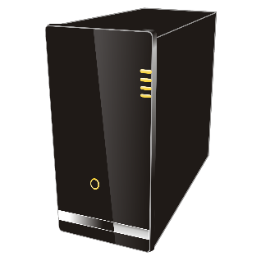

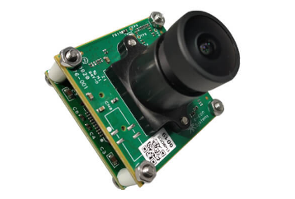
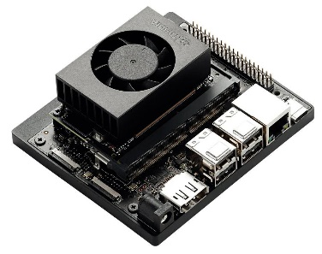
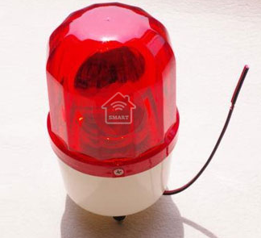
Solutions diagram:

Slide 6
Technology:
Jetson Nano
A powerful AI processor by NVIDIA designed for compact devices.
Advantages:
Supports popular AI frameworks (TensorFlow, PyTorch).
Excellent video and image processing capabilities.
Low power consumption (10W).
AI Model:
SSD-Mobilenet is used to re-train following this guideline: https://github.com/dusty-nv/jetson-inference
Dataset:
4 classes (Grenade, Gun, Knife, Pistol) consist of 1000 images.
Images are collected from Roboflow.
Label, Annotate and export to VOC format by using Roboflow tool

Slide 7
Demo:
Demo step:
- Configure your Jetson Nano with the provided library of TensorRT as per Nvidia provided guide to setup all necessary development environment for Jetson AI. (CSI Camera was used for this demo)
https://github.com/dusty-nv/jetson-inference/blob/master/docs/building-repo.md
- Unpack provided Mobilenet-ssd model for demo session in your Jetson Nano at this location.
/jetson-inference/python/training/dectection/ssd/models/weapon/
- Place provided weapon.py file in Jetson Nano detection/ssd folder and run the script with the following command to see Jetson Nano powered PPE detection program in action.
python3 weaponDetection.py /dev/video0

Slide 8
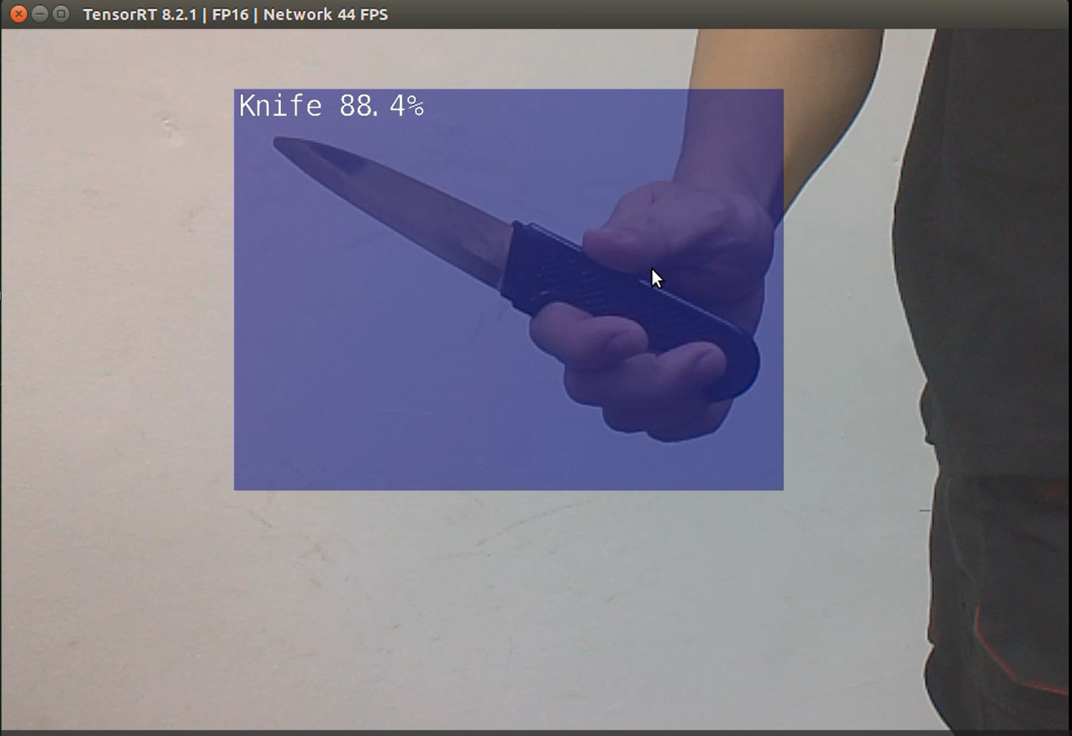
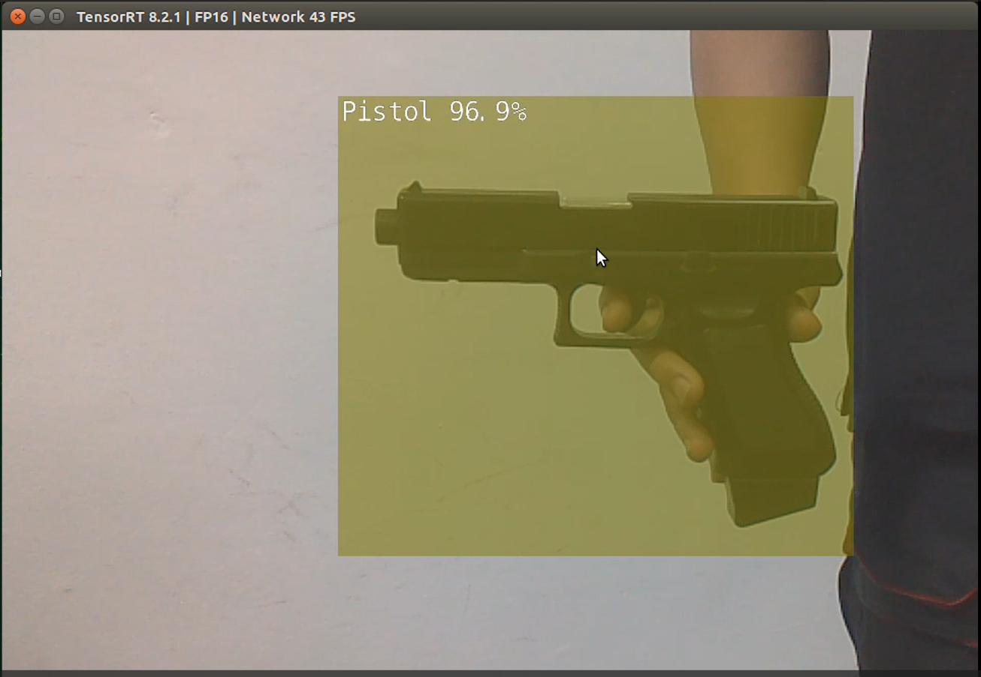
Images Demo:

